Slide 1
Summer Olympics

Slide 2
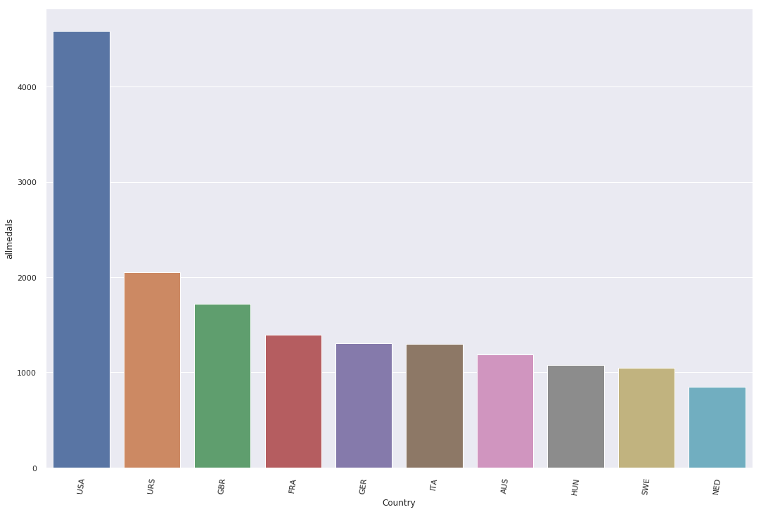
Countries with most number of medals won in all Olympics.

Slide 3
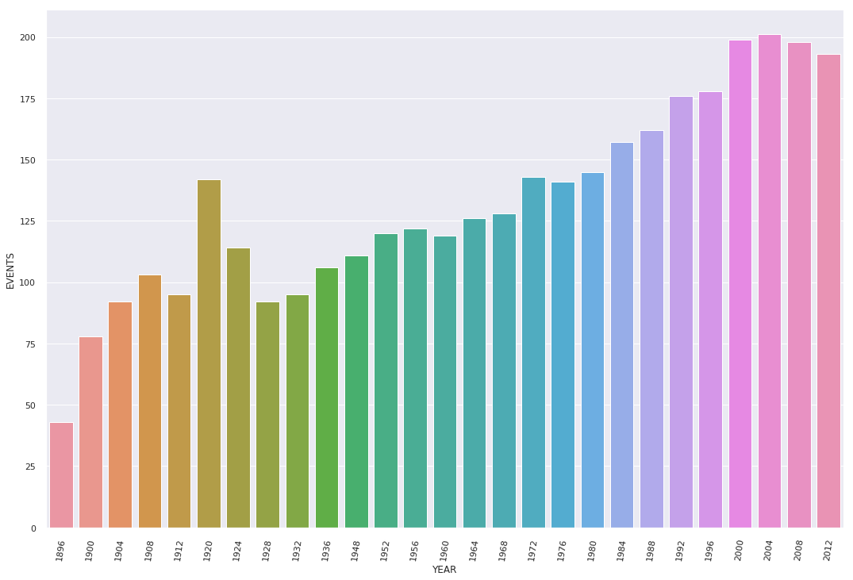
Number of Events held in each Olympics.

Slide 4
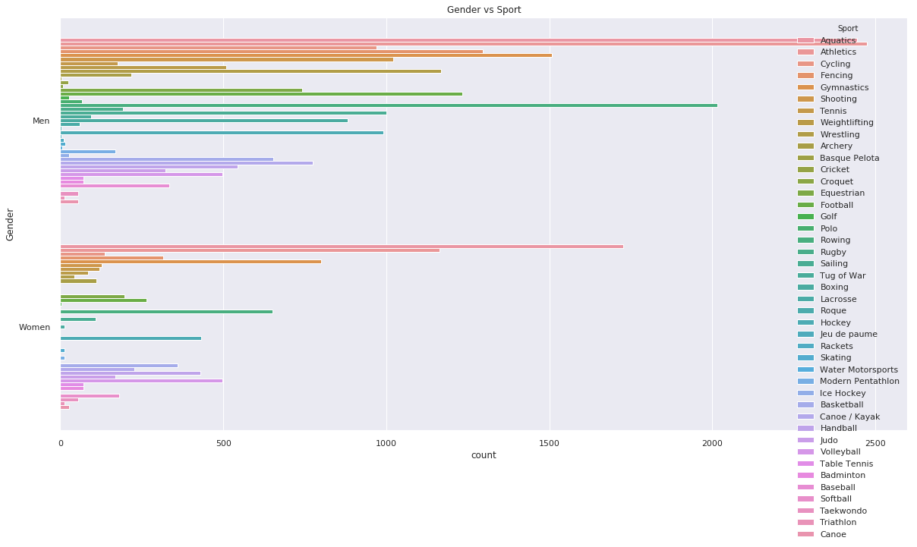
Number of Sports held in each olympics.

Slide 5
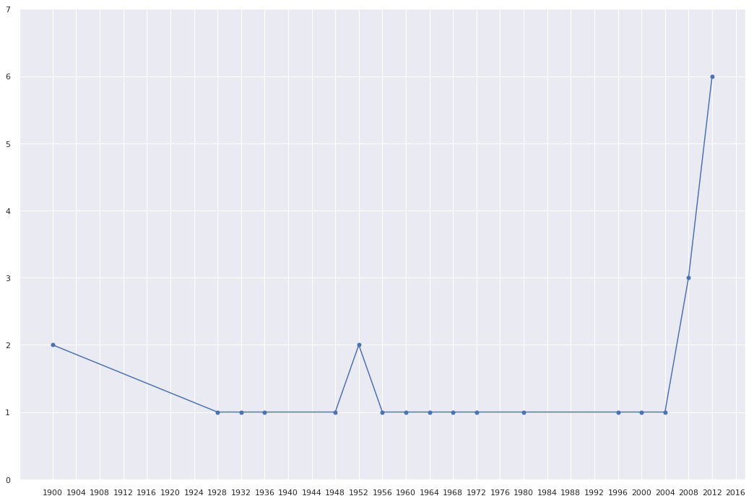
Plotting India's performance over the years

Slide 6
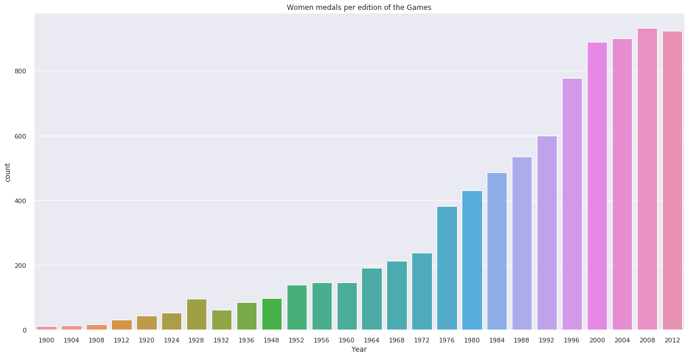
Women medals per edition of the Games

Slide 7
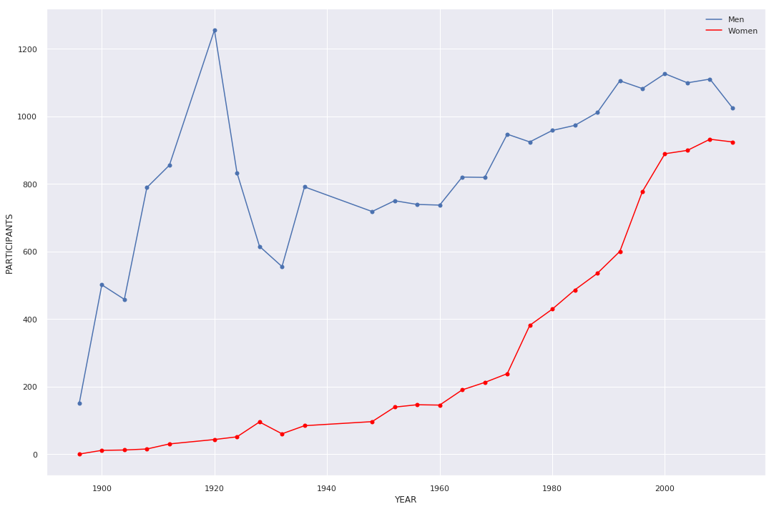
Gender Distribution in olympics

